Slide 1
Combinational Logic Circuit Comparator

Slide 2
Contents
Introduction of Comparator
Types
Comparator IC
Cascading Comparator
Applications

Slide 3
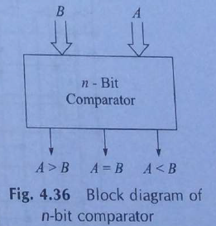
Introduction
Comparator
Compare two input signal or values and produce output depends on conditions on inputs.
Compare 2 binary numbers to find out which one is greater than or smaller than or equal to other number.
A A>B
A = B
B A<B

Slide 4
Comparator
Types
Identity Comparator
Magnitude Comparator
1-bit
2-bit
4-bit

Slide 5
Comparator
Identity Comparator
A digital comparator that has only one output terminal for when A = B either ―HIGH (A = B = 1) or LOW (A = B = 0).
Magnitude Comparator
A digital comparator which has three output terminals, one each for equality, A = B greater than, A > B and less than A < B.

Slide 6
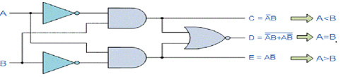
Magnitude Comparator
1-bit Magnitude Comparator
Two single bit numbers compared and 3 outputs to generate less than, greater than or equal to between two numbers.
Inputs |  | Outputs
A | B | A > B | A = B | A < B
0 | 0 | 0 | 1 | 0
0 | 1 | 0 | 0 | 1
1 | 0 | 1 | 0 | 0
1 | 1 | 0 | 1 | 0

Slide 7
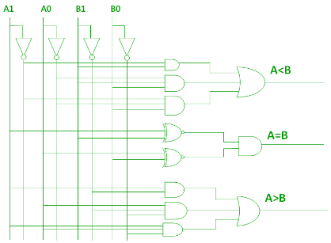
Magnitude Comparator
2-bit Magnitude Comparator
Compare 2 bit binary numbers and 3 outputs to generate less than, greater than or equal to between two numbers.
Inputs |  |  |  |  | Outputs
A1 | A0 | B1 |  | B0 | A > B |  | A = B | A < B
0 | 0 | 0 | 0 |  |  | 0 | 1 | 0
0 | 0 | 0 | 1 |  |  | 0 | 0 | 1
0 | 0 | 1 | 0 |  |  | 0 | 0 | 1
0 | 0 | 1 | 1 |  |  | 0 | 0 | 1
0 | 1 | 0 | 0 |  |  | 1 | 0 | 0
0 | 1 | 0 | 1 |  |  | 0 | 1 | 0
0 | 1 | 1 | 0 |  |  | 0 | 0 | 1
0 | 1 | 1 | 1 |  |  | 0 | 0 | 1
1 | 0 | 0 | 0 |  |  | 1 | 0 | 0
1 | 0 | 0 | 1 |  |  | 1 | 0 | 0
1 | 0 | 1 | 0 |  |  | 0 | 1 | 0
1 | 0 | 1 | 1 |  |  | 0 | 0 | 1
1 | 1 | 0 | 0 |  |  | 1 | 0 | 0
1 | 1 | 0 | 1 |  |  | 1 | 0 | 0
1 | 1 | 1 | 0 |  |  | 1 | 0 | 0
1 | 1 | 1 | 1 |  |  | 0 | 1 | 0

Slide 8
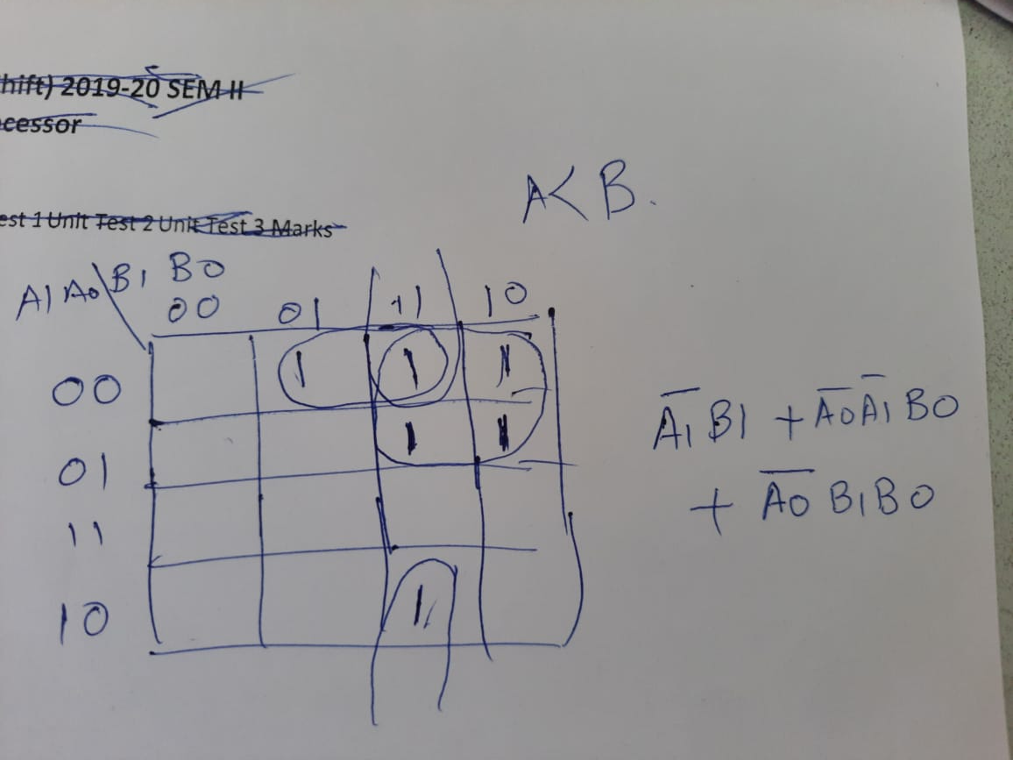
K map for A< B

Slide 9
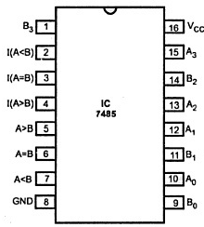
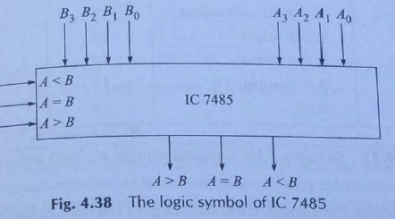
Comparator IC
Comparator IC used to compare 1-bit, 2-bit or 4-bit binary numbers.
If numbers are more than 4-bit, we require 2 or more 7485 IC’s.

Slide 10
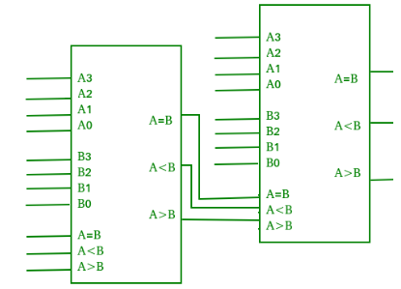
Cascading Comparator
When we want to compare more than 4-bit number by cascading 2 or more 4-bit comparators is called as Cascading comparator.
Lower comparator outputs are used as cascading inputs for upper comparator.

Slide 11
Application of Comparator
Process controller
Null detector
Password verification
Used in CPUs

